Slide 1
Data Structures
SPARSE MATRICES

Slide 2
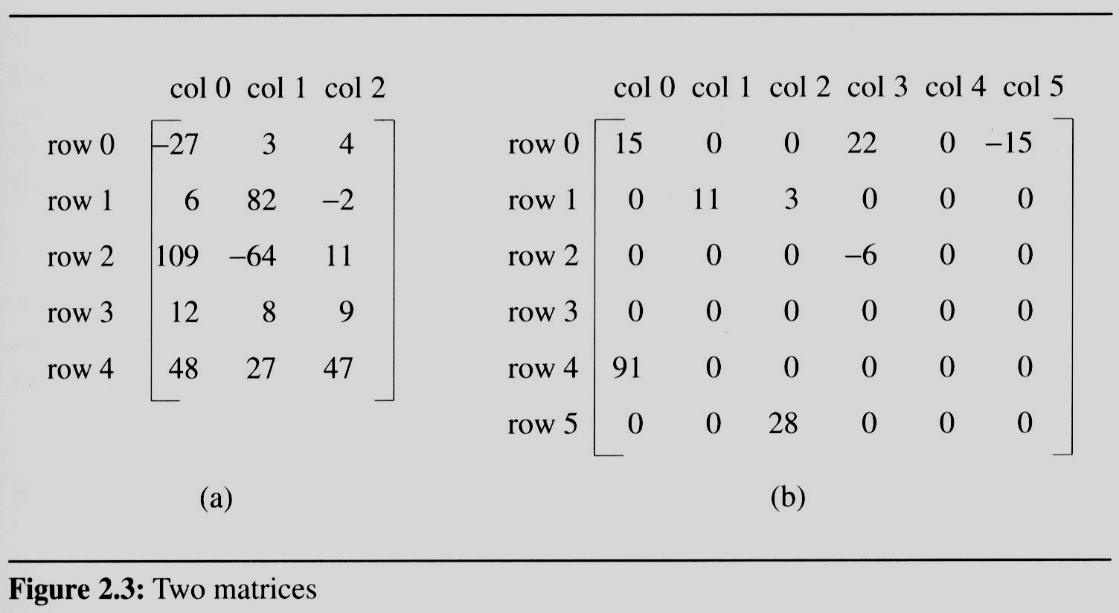
2.4 The sparse matrix ADT (1/18)
2.4.1 Introduction
  In mathematics, a matrix contains m rows and n columns of elements, we write m×n to designate a matrix with m rows and n columns.
sparse matrix
data structure?
5*3
15/15
6*6
8/36

Slide 3
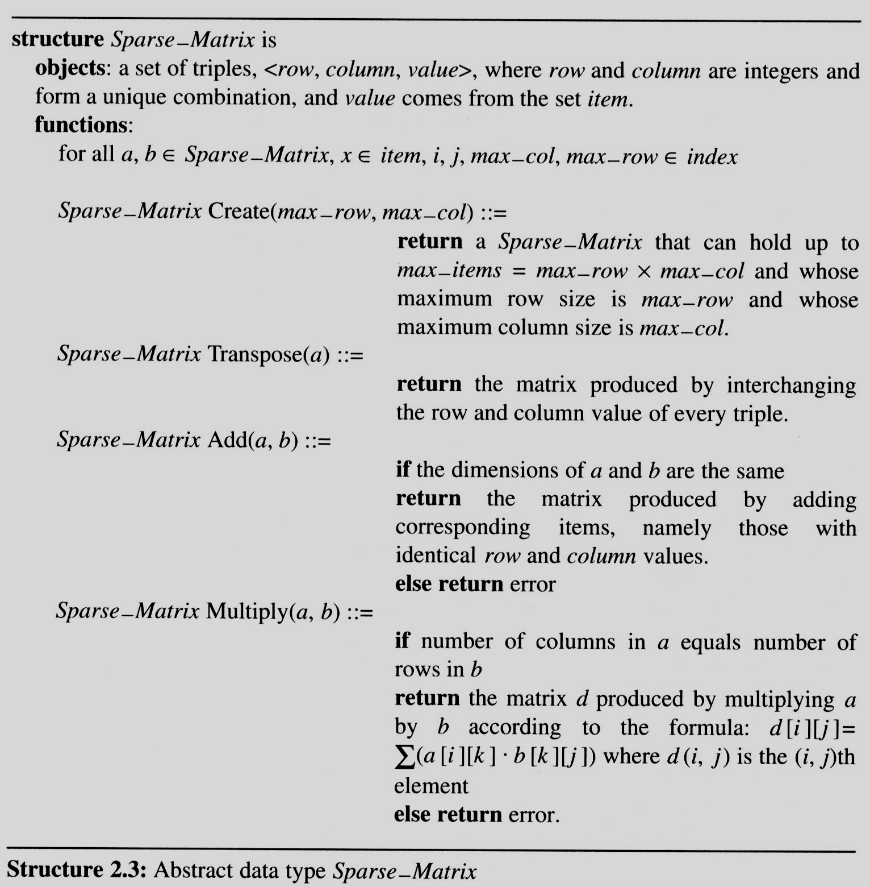
2.4 The sparse matrix ADT (2/18)
Structure 2.3 contains our specification of the matrix ADT.
  A minimal set of operations
    Matrix creation
    Addition
    Multiplication
    Transpose

Slide 4
2.4 The sparse matrix ADT (3/18)
The standard representation of a matrix is a two dimensional array defined as
a[MAX_ROWS][MAX_COLS]
  We can locate quickly any element by writing a[i ][ j ]
Sparse matrix wastes space
  We must consider alternate forms of representation.
  Our representation of sparse matrices should store only nonzero elements.
  Each element is characterized by <row, col, value>.

Slide 5
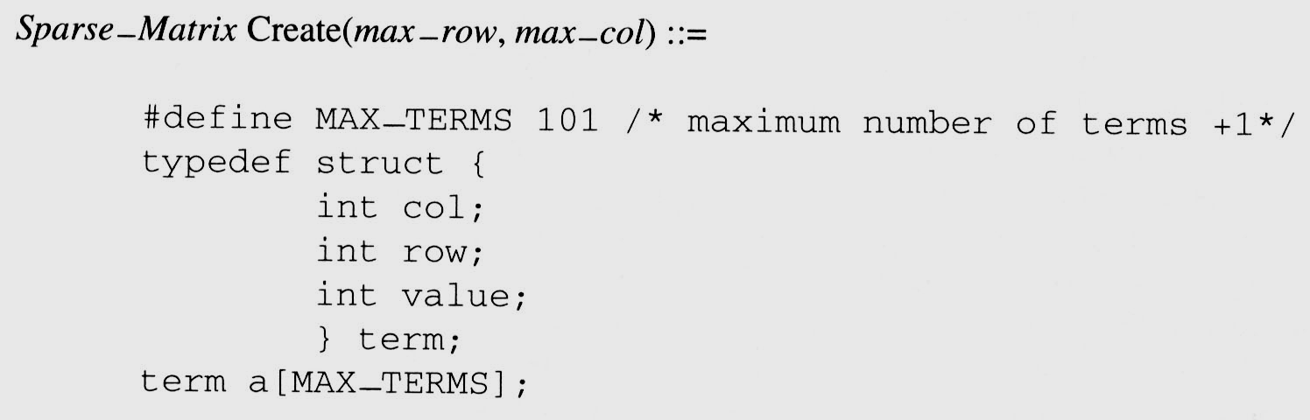
2.4 The sparse matrix ADT (4/18)
We implement the Create operation as below:

Slide 6
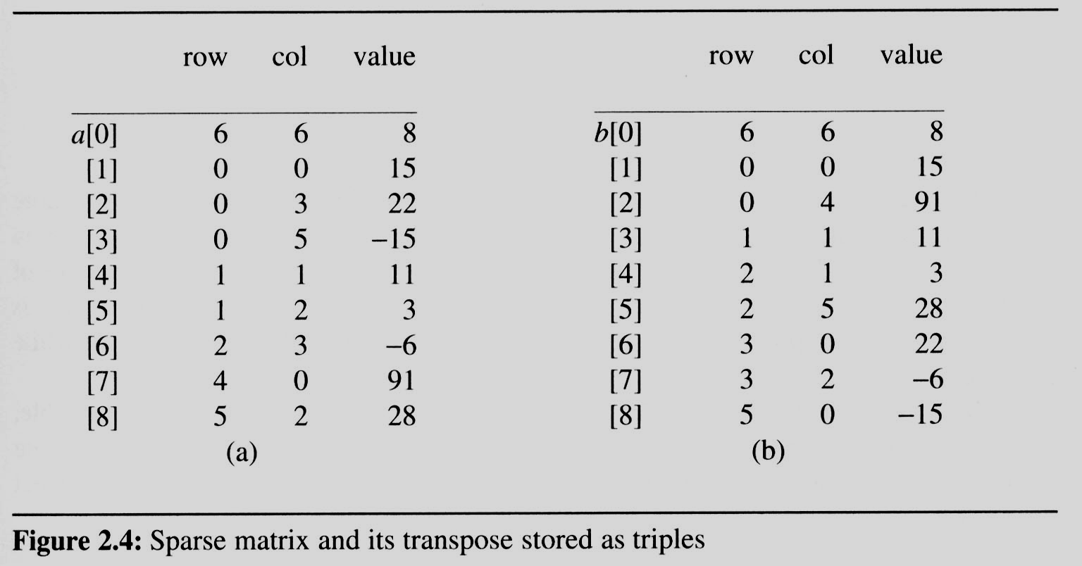
2.4 The sparse matrix ADT (5/18)
Figure 2.4(a) shows how the sparse matrix of Figure 2.3(b) is represented in the array a.
  Represented by a two-dimensional array.
  Each element is characterized by <row, col, value>.
# of rows (columns)
# of nonzero terms
transpose
row, column in
ascending order

Slide 7
2.4 The sparse matrix ADT (6/18)
2.4.2 Transpose a Matrix
  For each row i
    take element <i, j, value> and store it in element <j, i, value> of the transpose.
    difficulty: where to put <j, i, value>
    (0, 0, 15) ====> (0, 0, 15)
    (0, 3, 22) ====> (3, 0, 22)
    (0, 5, -15) ====> (5, 0, -15)
    (1, 1, 11) ====> (1, 1, 11)
    Move elements down very often.
  For all elements in column j,
    place element <i, j, value> in element <j, i, value>

Slide 8
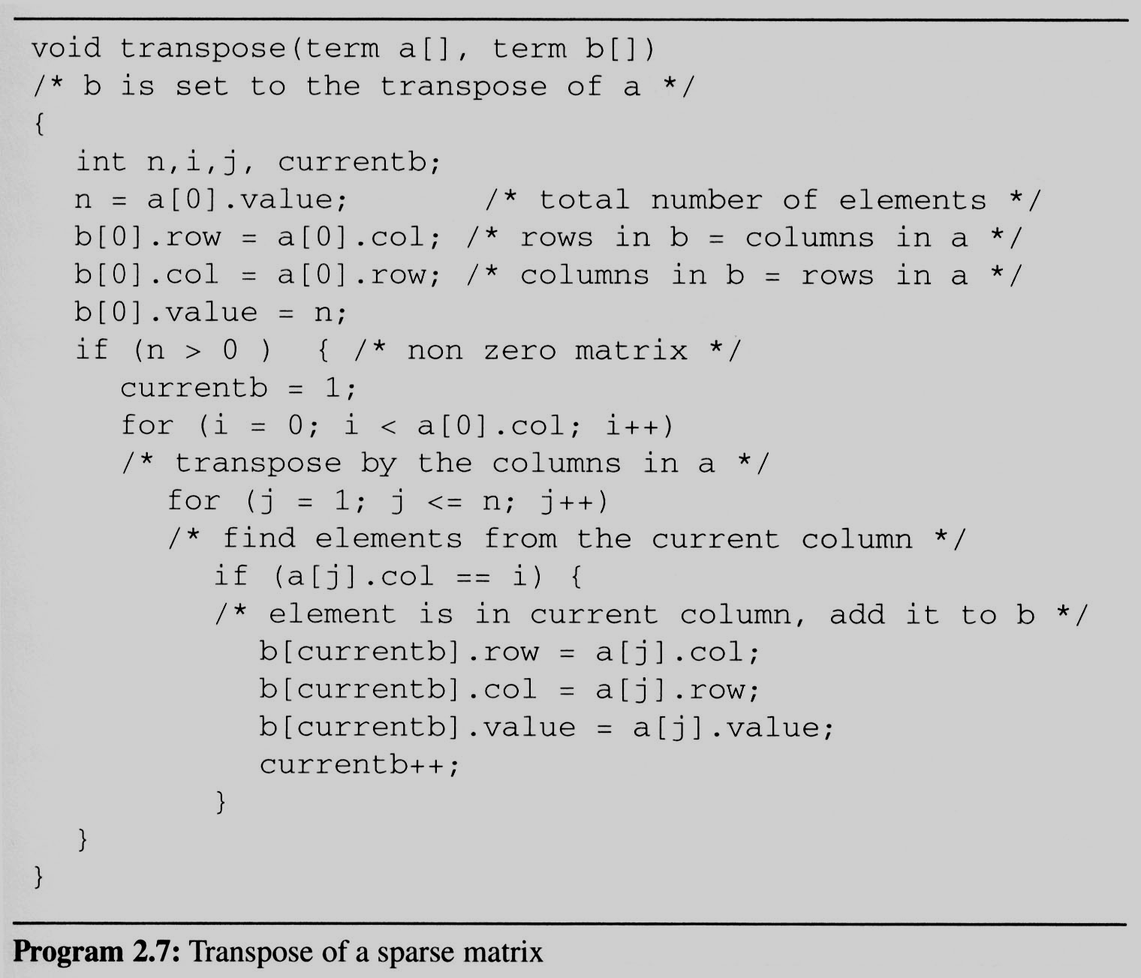
2.4 The sparse matrix ADT (7/18)
This algorithm is incorporated in transpose (Program 2.7).
Assign
A[i][j] to B[j][i]
place element <i, j, value> in element <j, i, value>
For all columns i
For all elements in column j
Scan the array
“columns” times.
The array has
“elements” elements.
==> O(columns*elements)

Slide 9
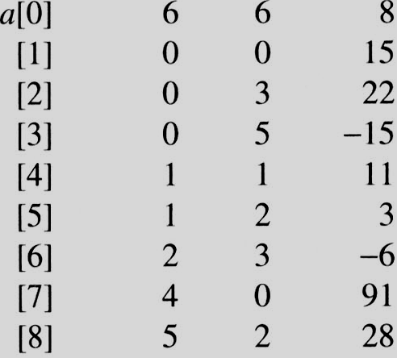
i=0 j=1
i=0 j=1
a[j]= 0 == i
i=0 j=2
i=0 j=2
a[j]=3 != i
i=0 j=3
i=0 j=3
a[j] = 5 != i
i=0 j=4
i=0 j=4
a[j].col = 1 a[j].col != i
i=0 j=5
i=0 j=5
a[j].col = 2 a[j].col != i
i=0 j=6
i=0 j=6
a[j].col = 3 != i
i=0 j=7
i=0 j=7
a[j].col = 0 == i
i=0 j=8
i=0 j=8
a[j].col = 2 != i
i=1 j=1
i=1 j=1
a[j].col = 0 != i
i=1 j=2
i=1 j=2
a[j].col = 3 != i
i=1 j=3
i=1 j=3
a[j].col = 5 != i
i=1 j=4
i=1 j=4
a[j].col = 1 == i
i=1 j=5
i=1 j=5
a[i].col = 2 != i
i=1 j=6
i=1 j=6
a[j].col = 3 != i
i=1 j=7
i=1 j=7
a[j] = 0 != i
i=1 j=8
EX: A[6][6] transpose to B[6][6]
i=1 j=8
a[i].col = 2 != i
Matrix A
Row Col Value
Set Up row & column in B[6][6]
Row Col Value
0 6 6 8
1 0 0 15
2 0 4 91
3 1 1 11
And So on…

